Slide 1
Water quality Analysis
Presented by : Sahil Bodke.
Vishal Chutiya.
Ankita Gaikwad.
Mayur Gaikar.
Mentor : Megha SAWANT

Slide 2
Sr No | CONTENTS
1 | INTRODUCTION
2 | Objectives
3 | Data Collection
4 | Working Model
5 | Import Libraries and data
6 | Data Cleaning And Preparation
7 | EDA i. Visualization of target features in every column. ii.Count of target features.
8 | Handling Imbalanced Data
9 | Model Deployement
10 | Conclusion

Slide 3
INTRODUCTION
Water is the most precious natural resource after air. Though the surface of the earth is mostly consists of water, only a small part of it is usable, which makes this resource limited.
Less than 50 per cent of the population in India has access to safely managed drinking water.
Poor condition of water bodies are not only the indictor of environmental degradation, it is also a threat to the ecosystem .
the quality of water is very important in both environmental and economic aspects.
Now water quality analysis is now consists of some standard protocols.
Now a days in some areas there is impure water supply for that I propose the water purity classifier to understand that water is safe or not.

Slide 4
Objectives
Less than 50 percent of the population in India don’t have safe water to drink.
Objectives is to check that water is drinkable.
Water quality analysis is used for to check whether water is safe to drink or not.
This machine learning model is used to check the purity of water.

Slide 5
Data Collection
Water Quality Dataset taken from Kaggle.
Water Quality Dataset is a collection of water quality which have been taken from water sample .
The dataset contains 10 columns and 3276 rows which are arrange according being water is safe to drink or not.

Slide 6
Working Model
Libraries Used :
Numpy – To perform wide variety of mathematical operations on arrays
Pandas – Provides various data structures and operations for manipulating numerical data.
Matplotlib and seaborn – For creating static, animated and interactive visualizations.
Sklearn – Tool for predictive data analysis. Features various classifications,regression and clustering algorithms.

Slide 7
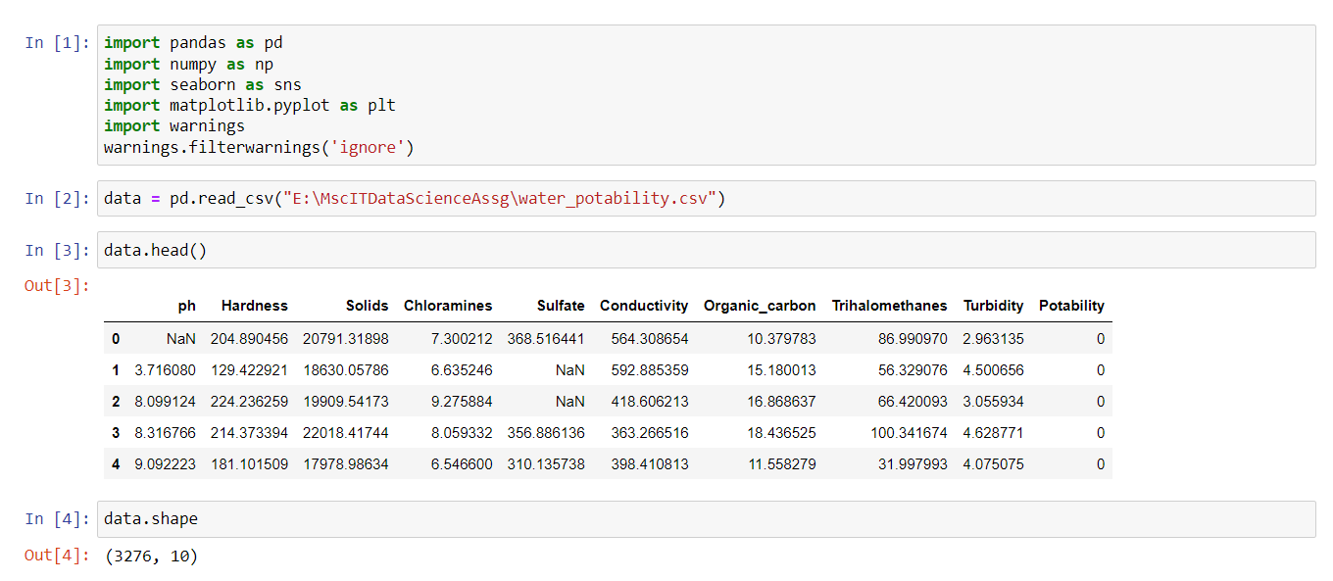
Import libraries and data

Slide 8
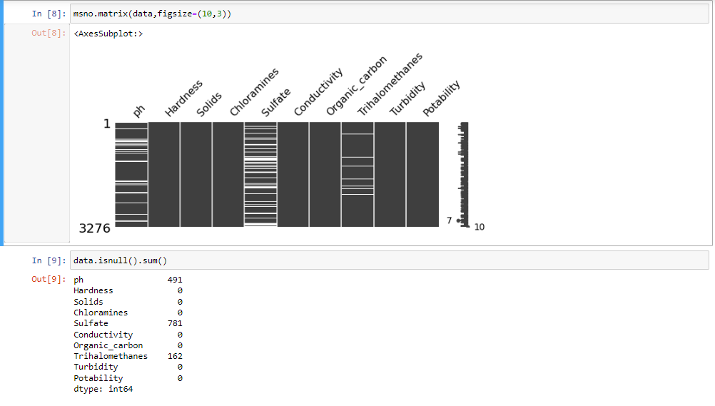
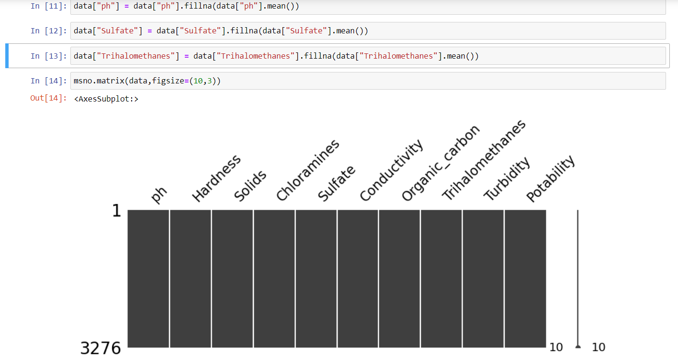
Data Cleaning and Preparation
Checking the null values of dataset with plots.
Taking the count of null values.
Replacing Null values with mean
Checking the null values of dataset with plots.

Slide 9
Exploratory Data Analysis

Slide 10
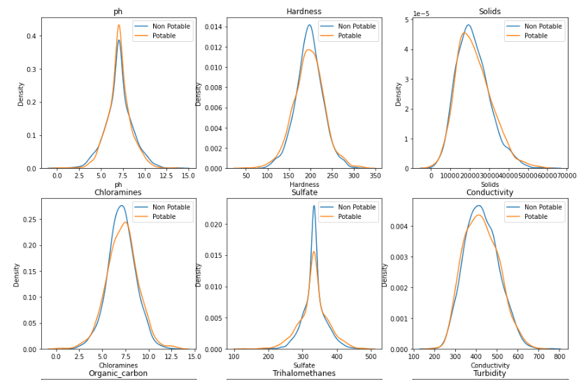
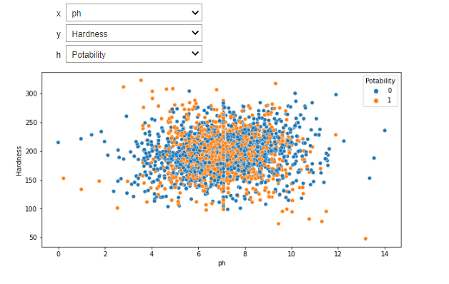
Visualization of Target features in every column
Checking the Potability in every column using line plot
Every columns have different Potability level.
Checking the Potability in every column using interact function & plotting scatter plot.

Slide 11
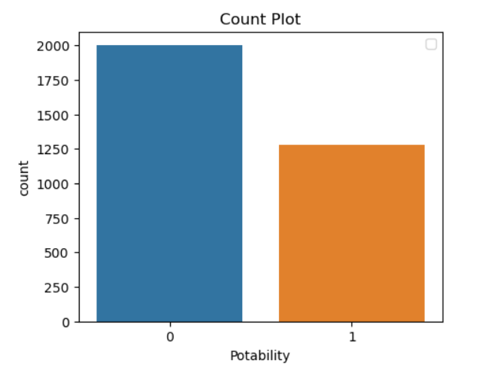
Count of target fEATURES
Checking the value count of Potability column.
Potability column contain two values 0 mean water is safe to drink and 1 means water is not safe to drink.
Zero is high in Potability and 1 is low and 0 contain 1998 values and 1 contain 1278 values.
By locking at count plot we can say that data are imbalance.

Slide 12
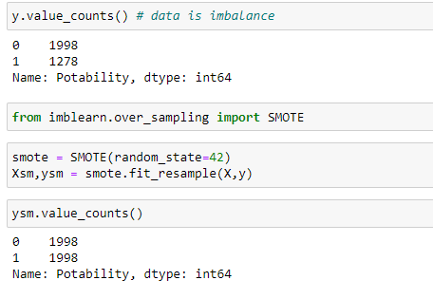
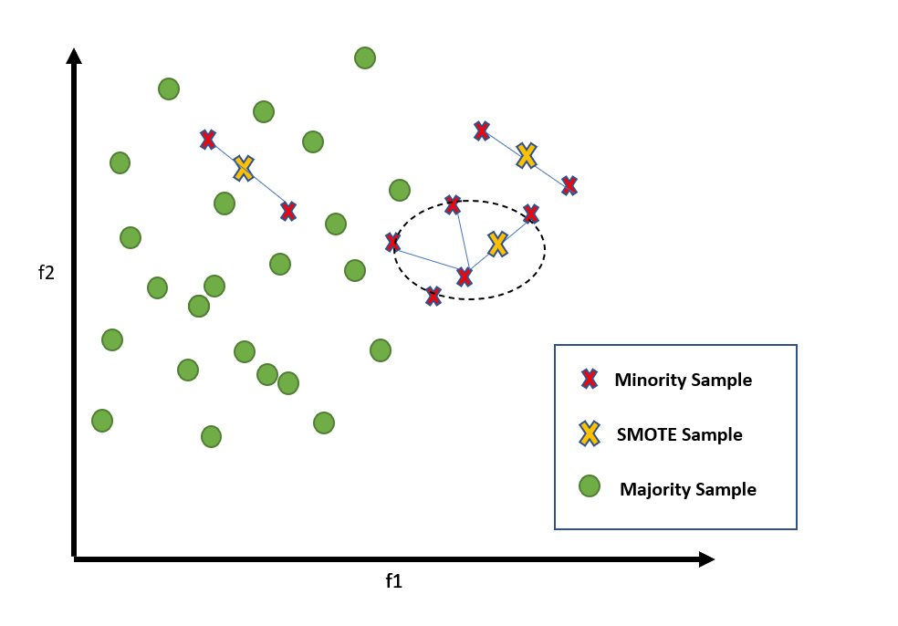
Handling Imbalance Data
By checking the values count of Potability column we can say that data is imbalance.
To handle data imbalance We have used smote function.
It target minority sample.
Smote function creating the smote sample of minority sample with same dimension.

Slide 13
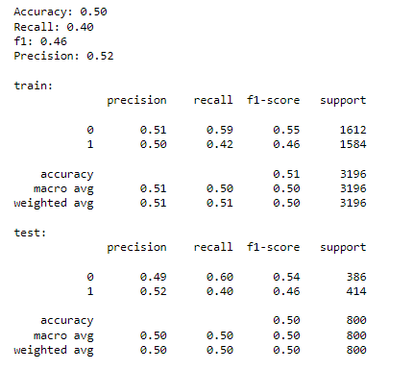
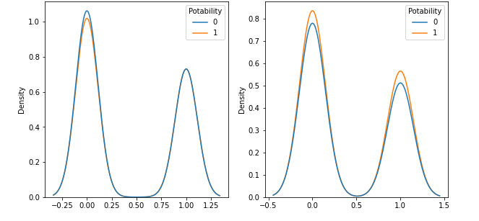
Model Deployment
I apply Logistics Regression model for deployment .
After deployment LR model give 50% accuracy.
Model are not able to separate to 0 and 1 .
0 and 1 and are overlapping on each other.

Slide 14
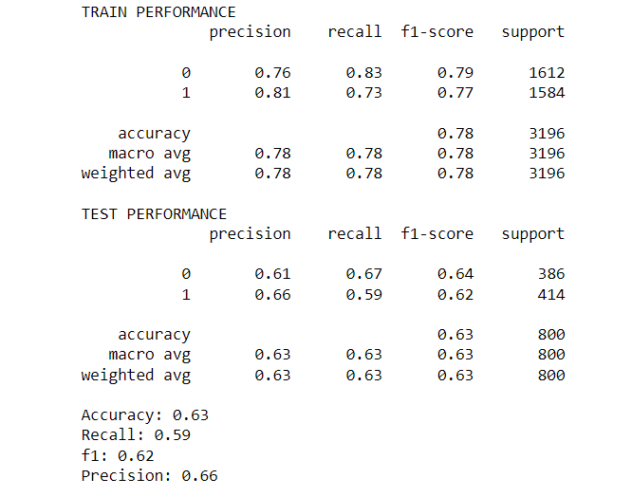
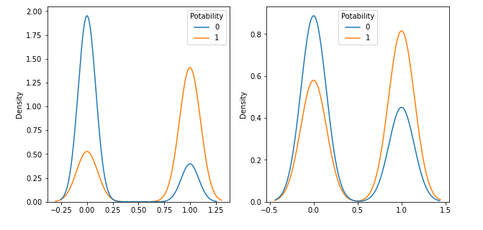
Model Deployment
I apply Decision Tree Regression model for deployment .
After deployment DS Classification model give 63% accuracy.
Model are able to separate to 0 and 1 .
0 and 1 and are not overlapping on each other

Slide 15
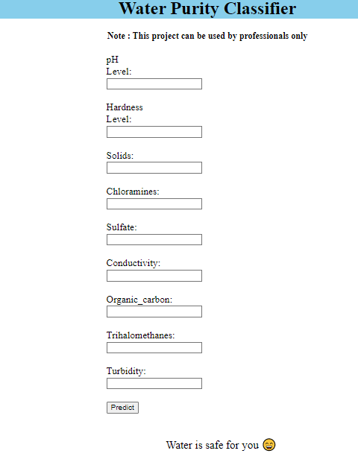
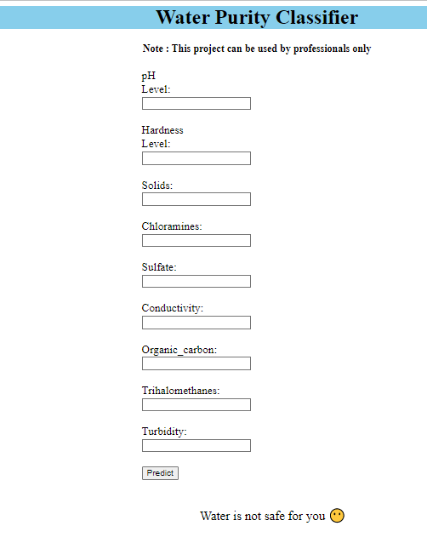
Front-End Development

Slide 16
Conclusion
This can be only use by water industry people only.
From this model water industry people can predict whether the water sample is safe to drink or not .
In future we can add more input parameter in the model.

